Slide 1

Spectrum Analyzers
UTA EE Labs

Slide 2
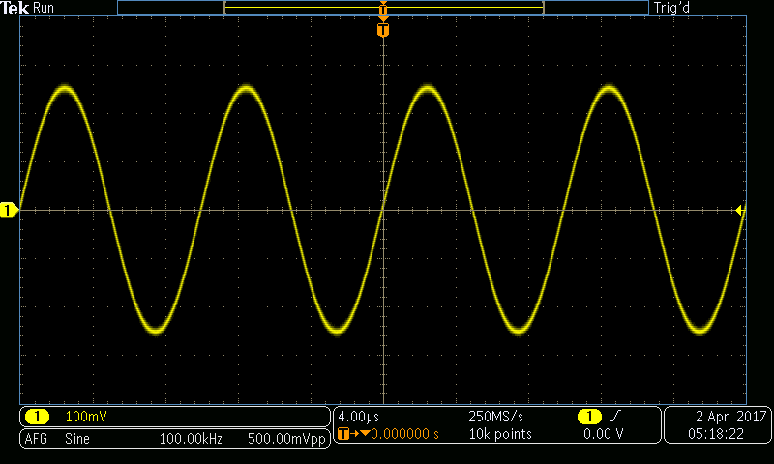
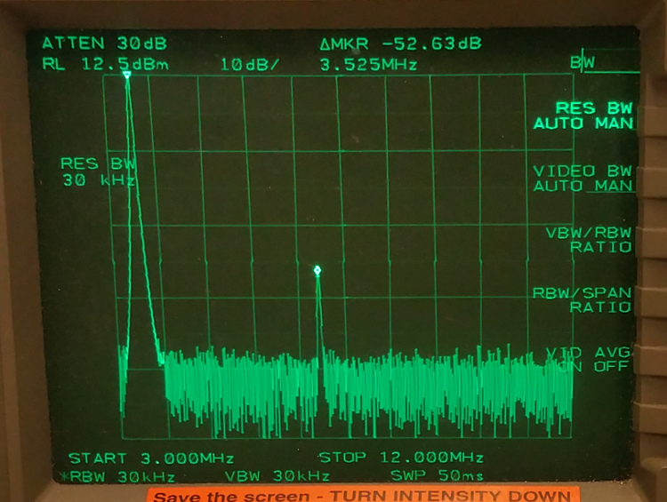
Oscilloscopes V Spectrum Analyzers
Amplitude axis
Amplitude axis
Time axis
Frequency axis

Slide 3
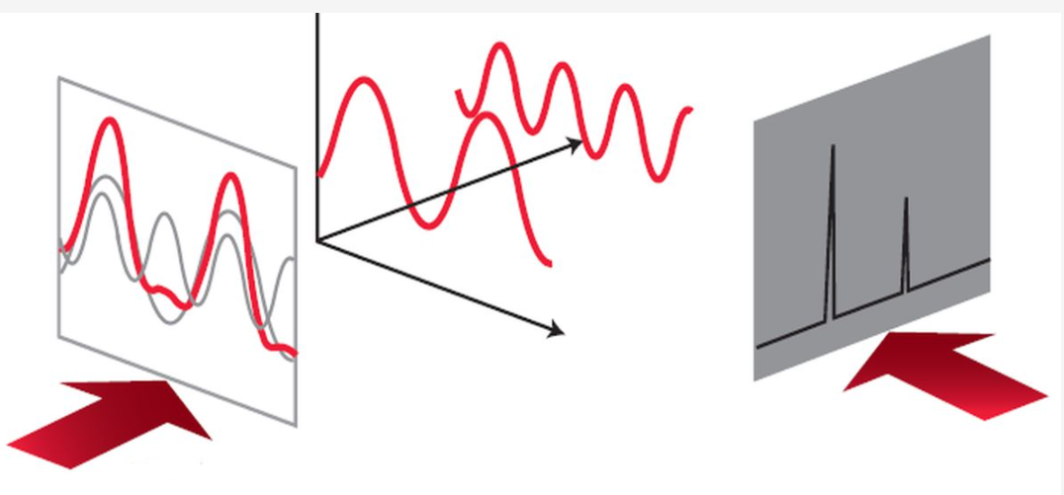
Time V Frequency
Time Domain
Frequency Domain

Slide 4
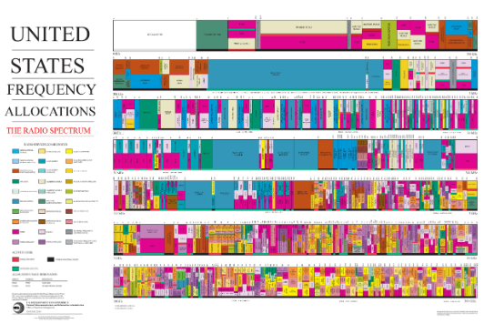
US Radio Spectrum
Spectrum Analyzers are used with Radio Frequency devices to ensure they do not interfere with other radio devices.
The US government leases spectrum to businesses like AT&T Verizon, NASA. Etc.

Slide 5
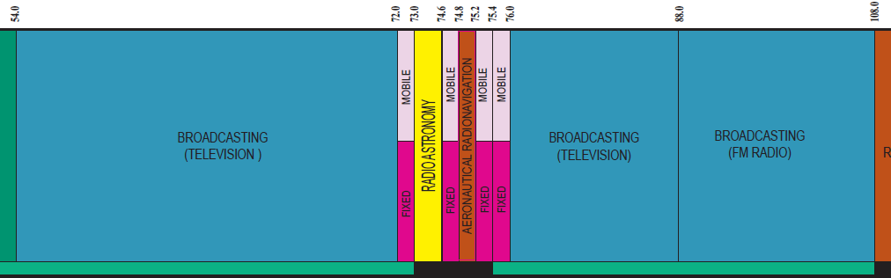
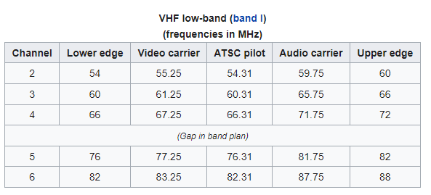
TV and FM Radio Allotment

Slide 6
Types of Spectrum Analyzers
Parallel filters measured simultaneously
A
FFT Spectrum Analyzer
The Fourier analyzer basically takes a time-domain signal, digitizes it using digital sampling, and then performs the mathematics required to convert it to the frequency domain and display the resulting spectrum.
Swept Spectrum Analyzer
The most common type of spectrum analyzer is the swept-tuned receiver. It is the most widely accepted, general-purpose tool for frequency-domain measurements. The technique most widely used is superheterodyne.
f
f
f
1
2
Filter 'sweeps' over range of interest

Slide 7
FFT Spectrum Analyzers
The analyzer is looking at the entire frequency range at the same time using parallel filters measuring simultaneously.
It is actually capturing the time domain information which contains all the frequency information in it.
With its real-time signal analysis capability, the Fourier analyzer is able to capture periodic as well as random and transient events.
It also can provide significant speed improvement over the more traditional swept analyzer and can measure phase as well as magnitude.

Slide 8
Swept Spectrum ( “Real Spectrum Analyzers”)
Very basically, these analyzers "sweep" across the frequency range of interest, displaying all the frequency components present.
The swept-tuned analyzer works just like the AM radio in your home except that on your radio, the dial controls the tuning and instead of a display, your radio has a speaker.
The swept receiver technique enables frequency domain measurements to be made over a large dynamic range and a wide frequency range.
It has significant contributions to frequency-domain signal analysis for numerous applications, including the manufacture and maintenance of microwave communications links, radar, telecommunications equipment, cable TV systems, and broadcast equipment; mobile communication systems; EMI diagnostic testing; component testing; and signal surveillance.

Slide 9
Spectrum Analyzer Block Diagram
RF input
attenuator
IF gain
IF filter
mixer
detector
Input
signal
Pre-Selector
Or Low Pass
Filter
Log
Amp
video
filter
local
oscillator
sweep
generator
Crystal
Reference
CRT display

Slide 10
Major Components
RF input attenuator
Mixer
IF (Intermediate Frequency) gain
IF filter
Video filter
Local oscillator
Sweep generator
Display.

Slide 11
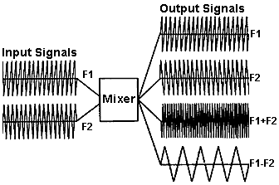
Mixer
A mixer is a device that converts a signal from one frequency to another.
It is sometimes called a frequency-translation device.
A mixer is a non-linear device (frequencies are present at the output that were not present at the input).
The output of a mixer consists of the two original signals (f_{sig} and f_{LO}) as well as the sum (f_{LO}+f_{sig}) and difference (f_{LO}-f_{sig}) frequencies of these two signals.
In a spectrum analyzer, the difference frequency is actually the frequency of interest. The mixer has converted our RF input signal to an IF (Intermediate Frequency) signal that the analyzer can now filter, amplify and detect for the purpose of displaying the signal on the screen.

Slide 12
IF Filter
IF FILTER
Input
Spectrum
IF Bandwidth
(RBW)
Display
Notes:
The IF filter is a bandpass filter which is used as the "window" for detecting signals.
It's bandwidth is also called the resolution bandwidth (RBW) of the analyzer and can be changed via the front panel of the analyzer.
By giving a broad range of variable resolution bandwidth settings , the instrument can be optimized for the sweep and signal conditions, letting trade-off frequency selectivity (the ability to resolve signals), signal-to-noise ratio (SNR), and measurement speed.
As RBW is narrowed, selectivity is improved (we are able to resolve the two input signals). This will also often improve SNR.

Slide 13
Video Filter
VIDEO FILTER
Notes:
The video filter is a low-pass filter that is located after the envelope detector and before the ADC.
This filter determines the bandwidth of the video amplifier, and is used to average or smooth the trace seen on the screen.
By changing the video bandwidth (VBW) setting, we can decrease the peak-to-peak variations of noise.

Slide 14
Other Components
LO
SWEEP GEN
frequency
CRT/LCD DISPLAY
RF INPUT ATTENUATOR
IF GAIN
Notes:
The local oscillator is a Voltage Controlled Oscillator (VCO) which in effect tunes the analyzer.
The sweep generator actually tunes the LO so that its frequency changes in proportion to the ramp voltage.
This also deflects the CRT beam horizontally across the screen from left to right, creating the frequency domain in the x-axis.
The RF input attenuator is a step attenuator located between the input connector and the first mixer. It is also called the RF attenuator.
This is used to adjust the level of the signal incident upon the first mixer.
This is important in order to prevent mixer gain compression and distortion due to high-level and/or broadband signals.
The IF gain is located after the mixer but before the IF, or RBW, filter.
This is used to adjust the vertical position of signals on the display without affecting the signal level at the input mixer.
When it changed, the value of the reference level is changed accordingly.
The IF gain will automatically be changed to compensate for input attenuator changes, so signals remain stationary on the CRT display, and the reference level is not changed.

Slide 15
Follow a signal
f
Signal Range
LO Range
s
f
f
-
f
LO
f
f
0
1
2
3
(GHz)
LO
s
LO
+
f
s
s
IF filter
mixer
0
1
f
2
3
4
5
6
detector
input
s
3.6
6.5
3.6
f
IF
sweep generator
A
LO
f
LO
0
1
2
3
(GHz)
f
3
4
5
6
(GHz)
CRT display
3.6
6.5
Notes:
First of all, the signal to be analyzed is connected to the input of the spectrum analyzer. This input signal is then combined with the LO through the mixer, to convert (or translate) it to an intermediate frequency (IF).
These signals are then sent to the IF filter.
The output of this filter is detected, indicating the presence of a signal component at the analyzer's tuned frequency. The output voltage of the detector is used to drive the vertical axis (amplitude) of the analyzer display.
The sweep generator provides synchronization between the horizontal axis of the display (frequency) and tuning of the LO. The resulting display shows amplitude versus frequency of spectral components of each incoming signal.
The horizontal arrows are intended to illustrate the "sweeping" of the analyzer. Starting with LO at 3.6 GHz, the output of the mixer has four signals, one of which is at 3.6 GHz (f_{LO}).
IF filter is also at 3.6 GHz (it's shape has been imposed onto the frequency graph for clarity). Therefore, we expect to see this signal on the display. At 0 Hz on the CRT, we do indeed see a signal - this is called "LO Feedthrough".
Sweep generator moving to the right, causes the LO to sweep upward in frequency. As the LO sweeps, so two will three of the mixer output signals (the input signal is stationary).
As the LO Feedthrough moves out of the IF filter bandwidth, we see it taper off on the display. As soon as the difference frequency (f_{LO}-f_{s}) comes into the envelop of the IF filter, we start to see it.
When it is at the center (e.g. 3.6 GHz) we see the full amplitude of this signal on the display.
And, as it moves further to the right, it leaves the filter envelop, and no signal is seen on the display.
The signal is being swept through the fixed IF filter, and properly displayed on the analyzer screen.

Slide 16
The Front Panel
Primary functions
(Frequency, Amplitude, Span)
Softkeys
8563A
SPECTRUM ANALYZER 9 kHz - 26.5 GHz
Control functions
(RBW, sweep time, VBW)
RF Input
Numeric
keypad

Slide 17
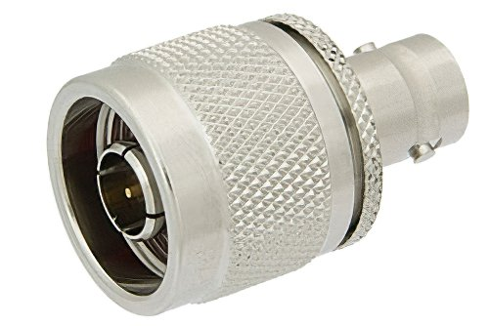
Hands on time
We will use a signal generator and a spectrum analyzer
A lot of equipment uses a N-Type connector. We’ll use a N-Type to BNC adapter so we can use BNC cables.
Install the N-Type to BNC adapter onto the Spectrum Analyzer.
Install a BNC to BNC cable from the signal generator into the spectrum analyzer.
Notes:
The BNC connector (initialism of "Bayonet Neill–Concelman") is a miniature quick connect/disconnect radio frequency connector used for coaxial cable. It is designed to maintain the same characteristic impedance of the cable,with 50 ohm and 75 ohm types being made. It is usually applied for video and radio frequency connections up to about 2 GHz and up to 500 volts. The connector has a twist to lock design with two lugs in the female portion of the connector engaging a slot in the shell of the male portion. The type was introduced on military radio equipment in the 1940's and has since become widely applied in radio systems, and is a common type of video connector. Similar radio-frequency connectors differ in dimensions and attachment features, and may allow for higher voltages, higher frequencies, or three-wire connections.

Slide 18

Hands on time
Set the signal generator to High Impedance mode (high Z mode)
Set the frequency to 1MHz
Set the Amplitude to 0 dBm :
Set the Spectrum Analyzer to 1MHz
Set the Span to 10 KHz
Adjust the amplitude to one division below the top of the screen.
Press Peak Search.
Do the amplitudes and Frequency match? Why or why not?
$$P_{dBm}=10\log_{10 } ({P_{watts}}/{1mW})$$
Notes:
The dBm increment is based on the decibel , a logarithm ic measure of relative power . Suppose a signal has a power level of P mW. Then the signal strength in dBm, symbolized S _{dBm} , is:
S _{dBm} = 10 log ₁₀ P
A 1-mW signal has a level of 0 dBm. Signals weaker than 1 mW have negative dBm values; signals stronger than 1 mW have positive dBm values.
2 milli watts is roughly 3 dBm
4 milli watts is roughly 6dBm
8 milli watts is roughly 9dBm
16 milli watts is roughly 12dBm
.01 watt is 10dBm
.0001 watts is roughly -10 dBm
Every 3 dBm you basically double the power

Slide 19
Why is this useful?
Easier to measure high frequencies. Does my amp, Amplify?
Measure low pass, high pass, notch and band pass filters.
Follow a signal through a circuit
See noisy oscillators/signals.

